Slide 1

NhiÖt liÖt chµo mõng c¸c thÇy, c«
Dù giê tiÕng anh líp 6b

Slide 2

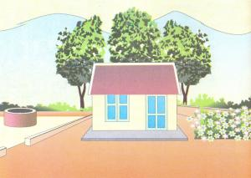

Checking up
a) There are the trees ................. the house.
b) There is a well .................. of the house.
c) There are the flowers .....................of
the house.
d) There is a yard................. of the house.
behind
to the left
to the right
in front

Slide 3

Monday, November 24th 2014
UNIT 7: YOUR HOUSE
Lesson 1: Period 39
Is your house big?: A1-2

Slide 4

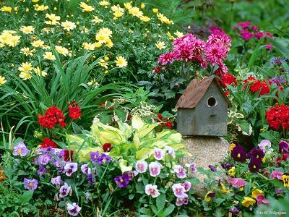
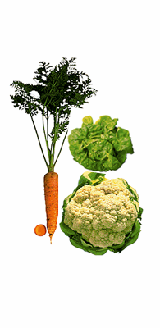
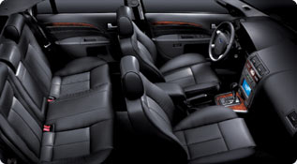
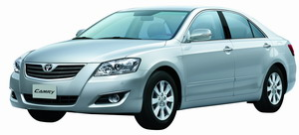
Period 39:Unit7. Your house-Lesson 1:A1-A2
I.Vocabulary:
a flower garden:
Vườn hoa
Front seat (n):
vegetables:(n)
Rau
a vegetable garden:
Vườn rau
any (adj):
Một ít, một chút, vài
old (adj):
cũ, già

Slide 5
Period 39:Unit7. Your house-Lesson 1:A1-A2
Matching
a flower garden:
vegetables:
a vegetable garden:
a well:
any:
old:
Vườn rau
Cái giếng
Một ít, vài
Cũ, già
Vườn hoa
rau

Slide 6
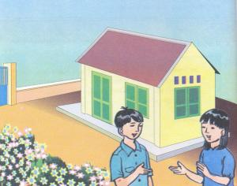
Period 39:Unit7. Your house-Lesson 1:A1-A2
II. Listen and read A1:
1. Grid. True / False questions:
1. Is your house big ?
 | yes | no
...big ?
…old ?
…a yard ?
...a well ?
…flowers ?
…trees ?
2. Is your house old ?
✓
3. Is there a yard ?
✓
4. Is there a well ?
5. Are there any flowers
in your yard?
✓
✓
6. Are there any trees
behind your house?
✓
✓

Slide 7
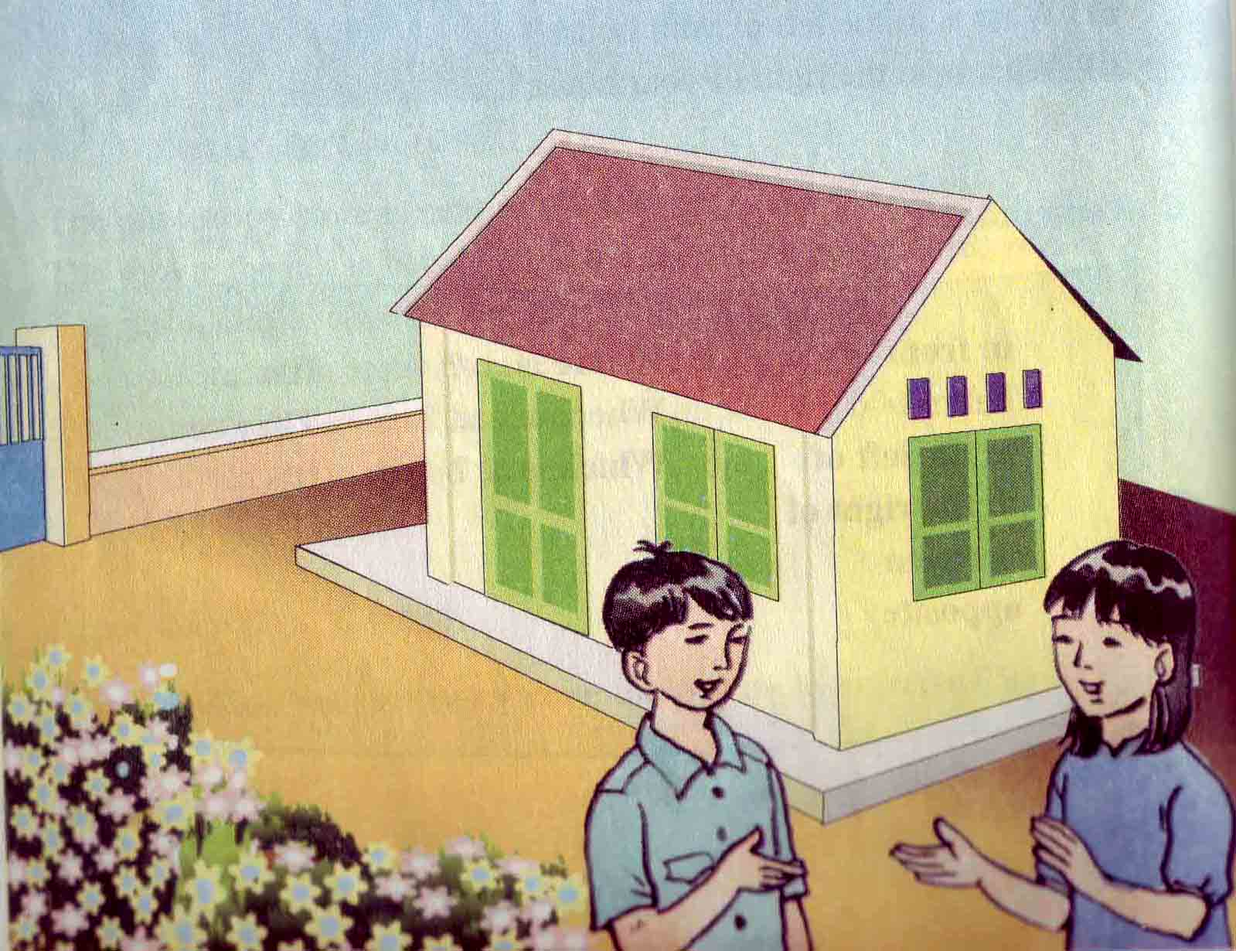
Period 39:Unit7. Your house-Lesson 1:A1-A2
II. LISTEN AND READ :
2. Read the dialogue:A1
Minh: Is your house big?
Hoa: No, it isn’t. It is small.
Minh: Is it old?
Hoa: Yes, it is.
Minh: Is there a yard?
Hoa: Yes, there is.
Minh: Is there a well?
Hoa: No, there isn’t.
Minh: Are there any flowers in your yard?
Hoa: Yes, there are.
Minh: Are there any trees?
Hoa: No, there aren’t.

Slide 8

Miêu tả ngôi nhà ta dùng: There is……...... ( N số ít ) There are..... ( Ns số nhiều )
Period 39:Unit 7: Your house-Lesson 1:A1-A2
*. Grammar:
Cấu trúc câu hỏi có cái gì không ?
Is there + a/an+ N? (vật gì )
Yes, there is / No, there isn’t
Are there + any + N(s/es)?
Yes, there are. / No, there aren’t

Slide 9
Period 39:Unit 7: Your house-Lesson 1:A1-A2
3. Practice:
S1: Is there a book?
S2: No, there isn’t./ Yes, there is.
S1: Are there any flowers?
S2: Yes, there are./ No, there aren’t
*. Make sentence with suggest word
a yard / x
Well / v
vegetable garden / x
Trees / v

Slide 10


Lucky numbers
1
Where is
Hoa’s house?
2
3
It is
in the country.
Yes, it is
Is it beautiful?
Lucky number
No, there isn’t
a well.
Is there a well?
4
5
Yes, there are
Are there any
flowers ?
6
Lucky number

Slide 11
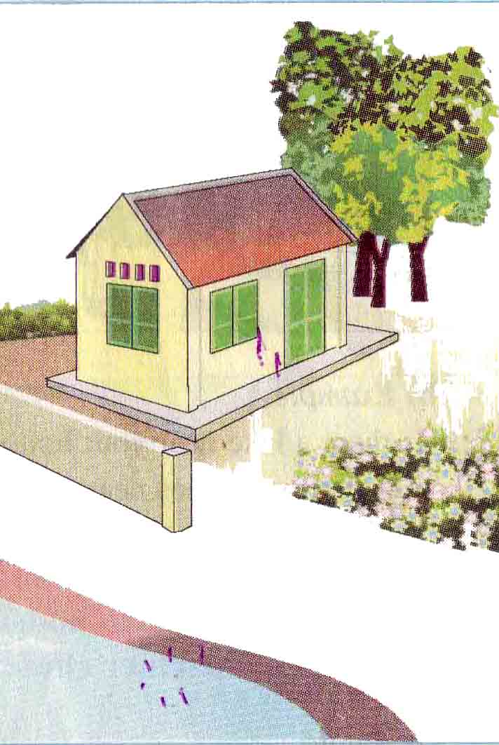
Period 39:Unit7. Your house-Lesson 1:A1-A2
III. Practice: A.2 /P.73.
1. Read the letter
Dear Lan,
Thank you for your letter. I’m in
the country with my friend Thanh
She lives in a beautiful house.
There is a flower garden in front
of the house. There is a vegetable
garden behind the house. To the
left of the house, there is a lake.
To the right of the house, there
are tall trees.
Here is a photo

Slide 12
Period 39:Unit7. Your house-Lesson 1:A1-A2
2. Matching the questions
and answers:.
Is there a flower garden in front of the house? b. Is the house beautiful ? c. Is there a flower garden behind the house ? d. Is the lake to the right of the house ? e. Is Nga in the city ? | A. Yes, it is B. No, it isn’t C. No, she isn’t D. Yes, there is E. No, there isn’t

Slide 13
Period 39:Unit7. Your house-Lesson 1:A1-A2
IV. Write about your house.
My house.
There’s a flower garden in front of the house. There’s a vegetable garden behind the house. To the left of the house, there’s a lake. To the right of the house, there are tall trees. Here is a photo.

Slide 14

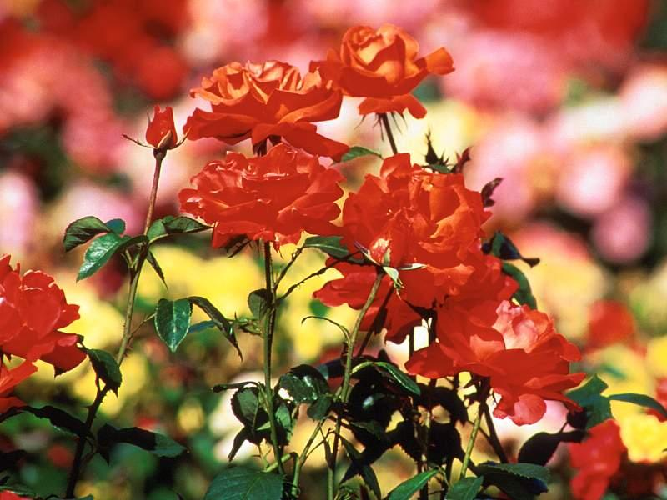
Period 39:Unit7. Your house-Lesson 1:A1-A2
Homework
- Learn by heart vocabulary. - Describe your house and draw a
picture of it as a photo.
- Do Ex A.1,2 ( Ex-book ) / P.67

Slide 15

Thank you for your attention
good bye , see you again !

