Slide 1
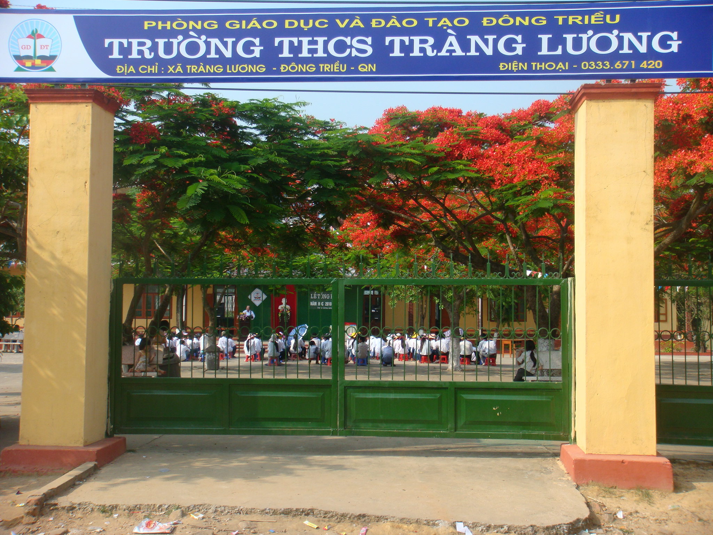
Well come
to our school !

Slide 2

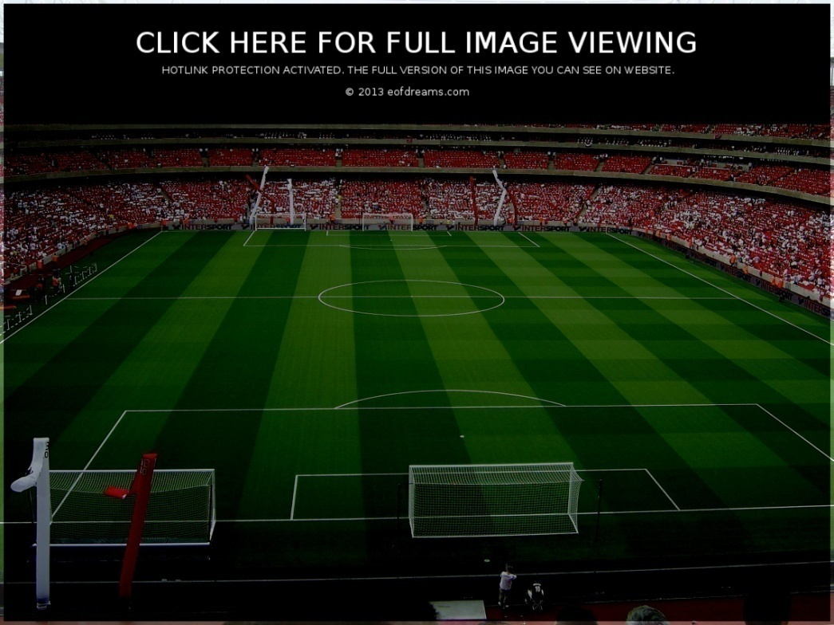

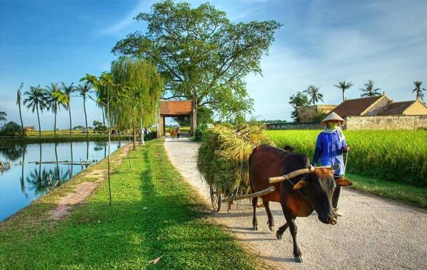
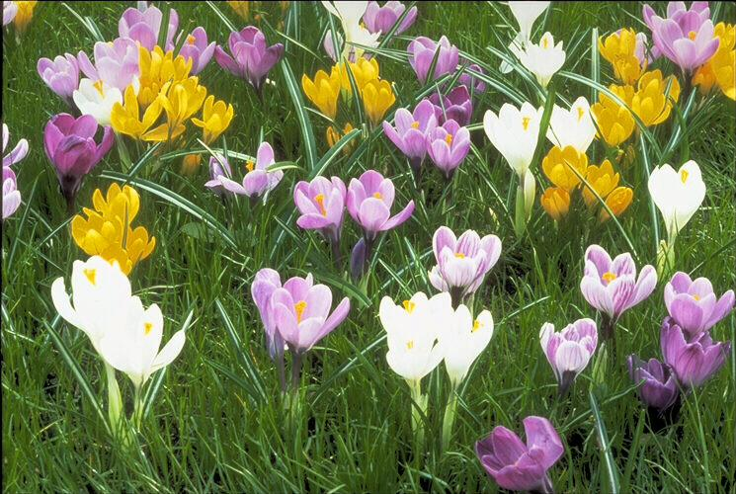

*.Warm up:
Crosswords
1
Y
A
R
D
A
2
H
O
S
P
I
T
A
L
H
3
C
O
U
N
T
R
Y
O
4
S
T
A
D
I
U
M
U
5
F
L
O
W
E
R
S
S
6
T
R
E
E
E
Our house has a big ……..
RED
YELLOW

Slide 3

Monday, November 17th 2014
UNIT 6: PLACES
Lesson 4: Period 36
Around the house: C1 - 2

Slide 4
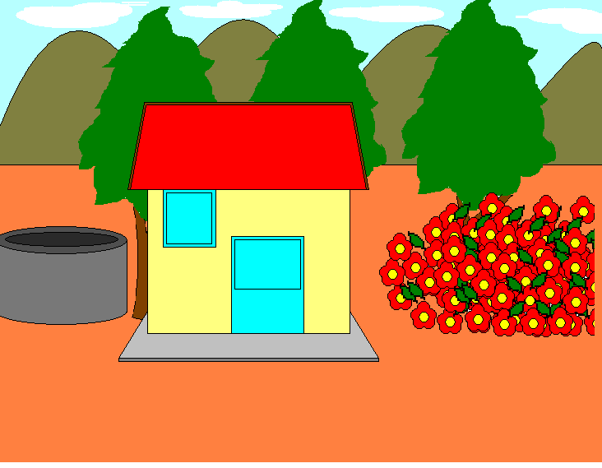

Unit 6: Lesson 4: Around the house: C1-2
*. New words
What is this?
- a well (n):
Cái giếng
- a mountain:(n)
Ngọn núi
- in front of :(prep)
Phía trước
What is this?
- behind :(prep)
Phía sau
- to the left of :( prep)
Bên trái
- to the right of :( prep)
Bên phải

Slide 5

Unit 6: Lesson 4: Around the house: C1-2
What and where?
1
2
in front of
a well
3
to the right of
5
4
to the left of
behind
6
a moutain

Slide 6

Listen and read
Look at the house.
In front of the house, there is a big yard.
Behind the house, there are tall trees
Behind the tall trees, there are mountains
To the left of the house, there is a well
To the right of the house, there are flowers

Slide 7

Unit 6: Lesson 4: Around the house: C1-2
Prediction:
Answer True (T) or False ( F)
1.There is a big yard
to the left of the house.
in front of the house.
F
2.There are tall trees behind the house.
T
3.There is a well
to the right of the house.
to the left of the house.
F
4.There are mountains behind the tall trees
T
5.There are flowers to the right of the house.
T

Slide 8
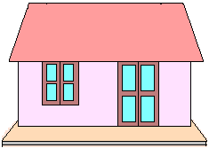
Unit 6: Lesson 4: Around the house: C1-2
1. Model Sentences:
- Where is the tree?
It is to the left of the house
- Where are the trees?
They are to the right of the house.
2. Remember:
Where is + N ? -> It is + preposition + N
Where are + N(s,es) ? -> They are + preposition + N
Dùng để hỏi xem cái gì ở đâu?

Slide 9
Unit 6: Lesson 4: Around the house: C1-2
Answer the questions:
Lucky numbers
1
2
3
4
5
Good luck !
6
7
8
9
10
RED
YELLOW

Slide 10
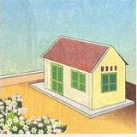
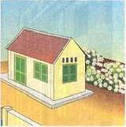
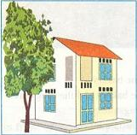
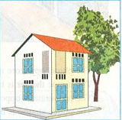
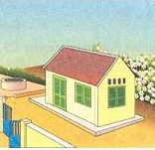
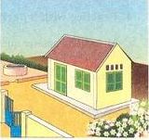
1. Listen and find the right picture.
Further practice
? Which is different?
A
a) Which is Ba’s house ?
A
B
? Which is different?
B
b) Which is Lan’s house ?
A
B
? Which is different?
B
c) Which is Tuan’s house ?
A
B

Slide 11
Unit 6: Lesson 4: Around the house: C1-2
2. Write about 3 houses above.
a) Ba lives in a beautiful house. There are flowers in front of his house.
Ba’s house
Lan’s house
b) Lan lives in a big house. There is a tall tree to the right of her house.
c) Tuan lives in a small house. There is a well to the left of his house and there are beautiful flowers to the right of his house.
Tuan’s house

Slide 12
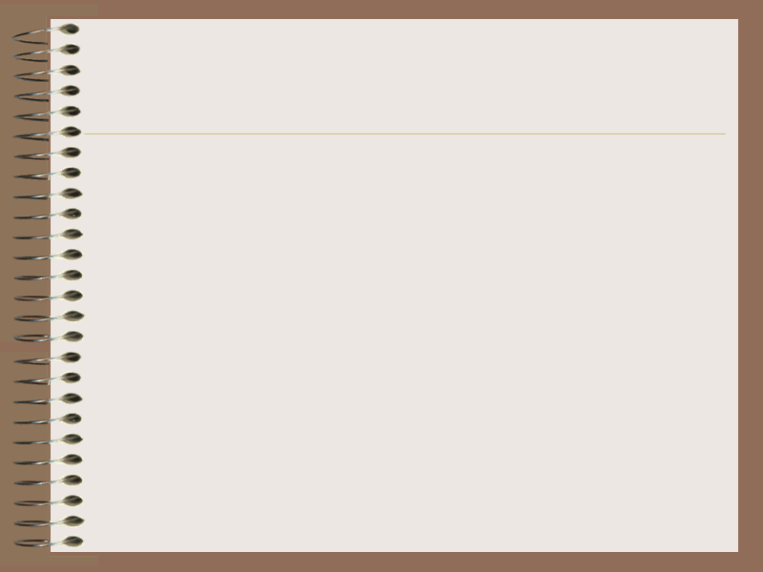
1. Listen and find the right picture.
Unit 6: Lesson 4: Around the house: C1-2
Consolidation
I. New words
II. Listen and read.
Where is + N ? -> It is + preposition + N
Where are + N(s,es) ? -> They are + preposition + N
-> Dùng để hỏi xem cái gì, ở đâu ?
III. Practice:
2. Practice write about the house

Slide 13
Unit 6: Lesson 4: Around the house: C1-2
Homework
- Learn by heart new words.
Write 5 – 7 sentences about your house.
- Prepare the next lesson: C3 - 4

Slide 14
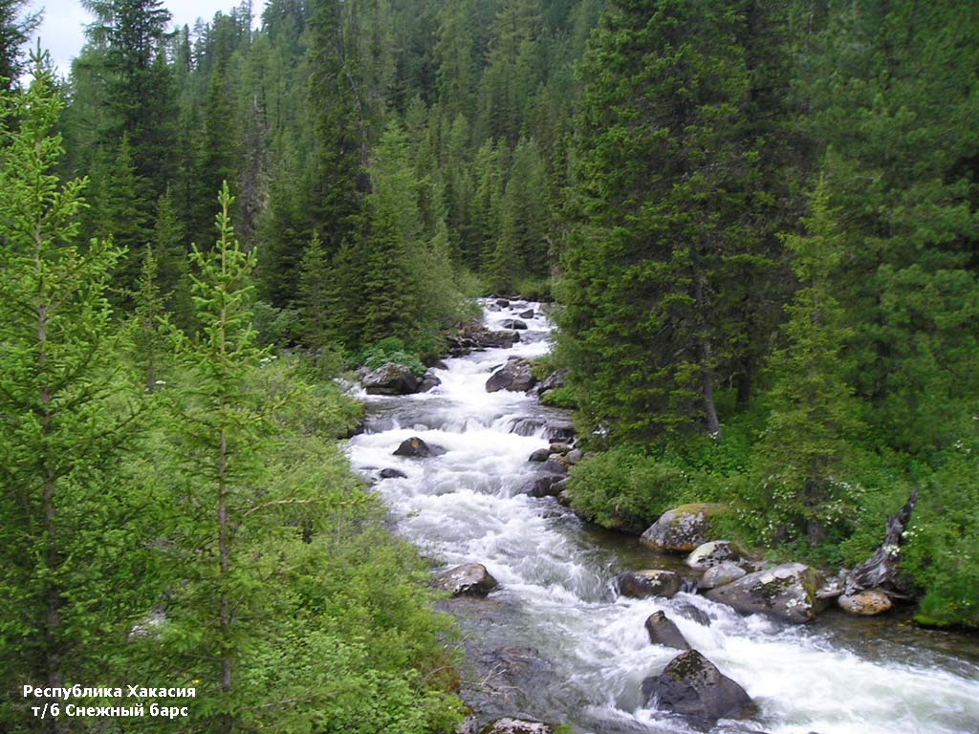
THANK YOU
FOR YOUR ATTENTION !
Goodbye !

Slide 15
a) Where is the yard?
It’s in front of the house.

Slide 16
b) Where are the tall trees?
They are behind the house.

Slide 17
c) Where are the moutains?
They are behind the trees

Slide 18
d) Where is the well?
It’s to the left of the house.

Slide 19
e) Where are the flowers?
They’re to the right of the house.

Slide 20
f) Where is the house?
It’s in front of the trees.

Slide 21
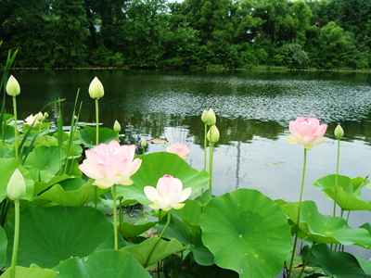
lucky number

Slide 22

You are lucky

Slide 23
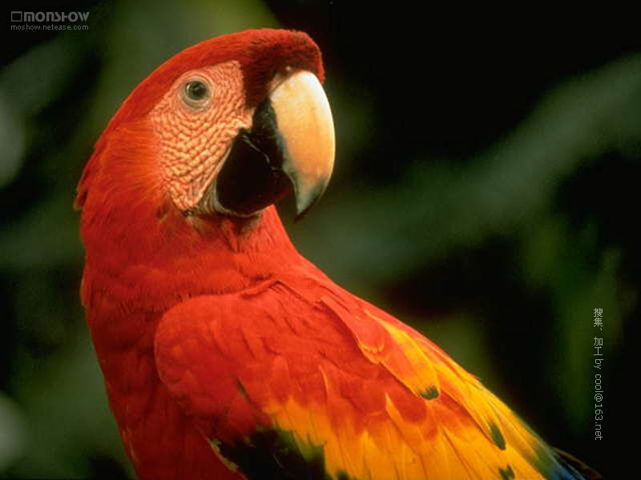
lucky number

Slide 24

Lucky number

